Slide 1
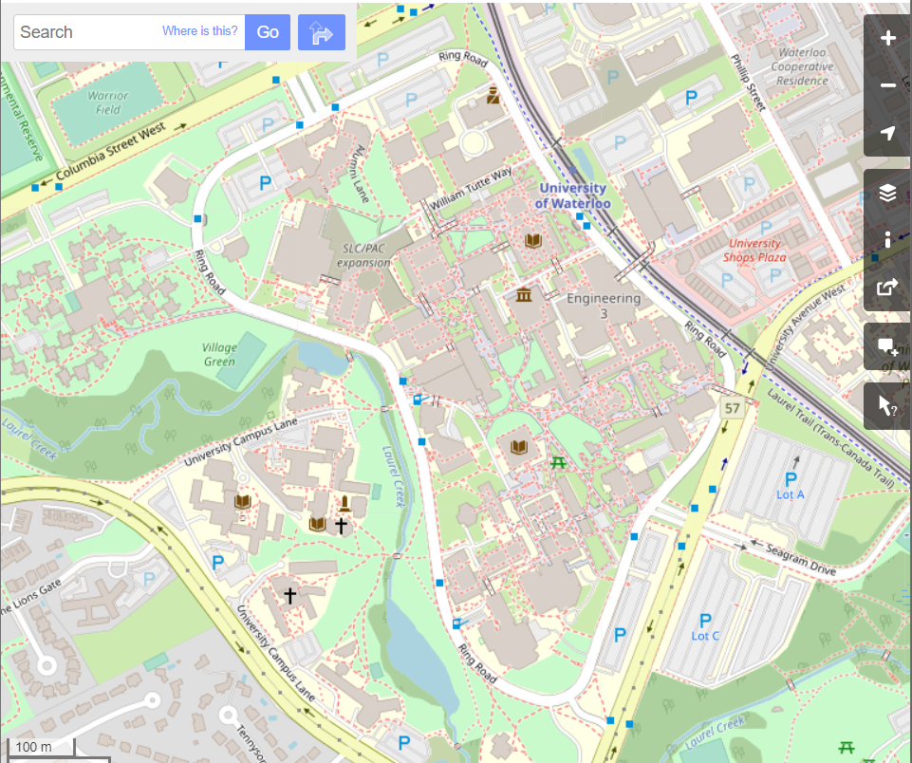
GIS Lesson 12
Web mapping (1)
INTRO TO WEB MAPPING AND Openstreetmap
2020/8/5

Slide 2
Agenda
1. Today’s Class
2. Tutorial
Web Mapping (1) – OpenStreetMap (OSM)
Edit spatial data
Example coursework
Demonstration in OSM
What is Web Mapping?
Introduction to OSM
Edit attribute data
Find neighborhood(s) of interest
Download OSM data and create a map in QGIS
Web 1.0 to Web 2.0

Slide 3
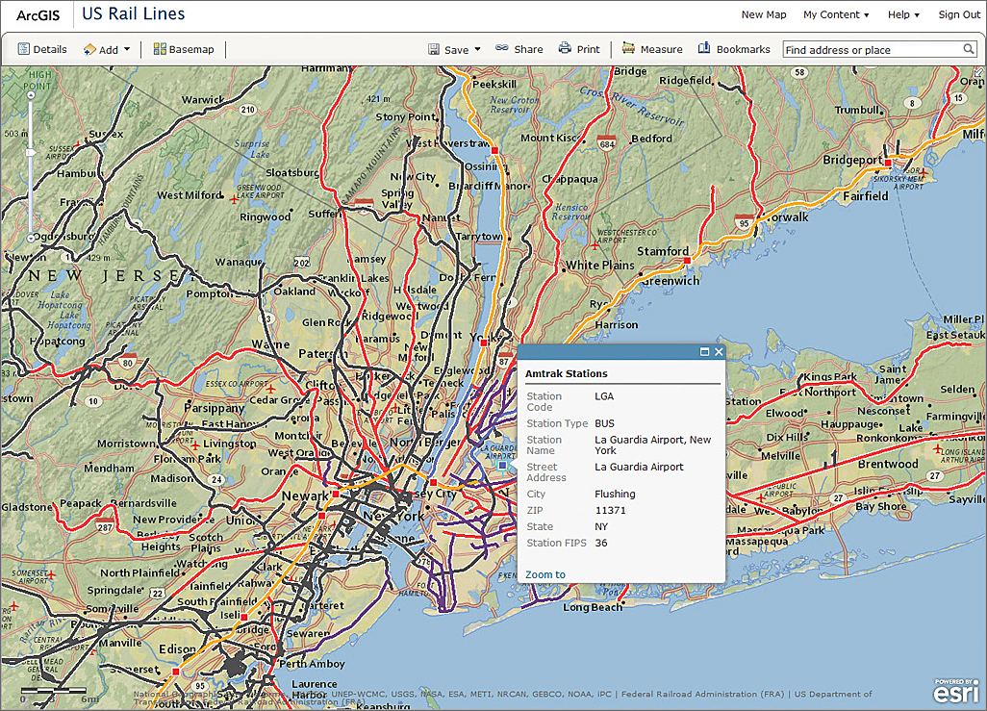
What is Web Mapping?
Web Mapping:
The process of using the maps delivered by GIS in the Internet.
The use of software tools to facilitate the generation of online maps, simple analysis, and the visualization and downloading of data
Types of Web Maps
Static web maps (e.g. view only maps without interactivity, often in .jpg, .gif or .pdf formats)
Interactive (Dynamic) web maps
Analytical web maps (mainly for analysis of geodata)
Animated and realtime web maps (maps showing temporal changes)
Collaborative web maps (allows users to collaborate to create and improve, e.g. OpenStreetMap, Google MyMaps)
Source: https://www.esri.com/news/arcuser/0612/creating-custom-web-mapping-applications-without-programming.html

Slide 4
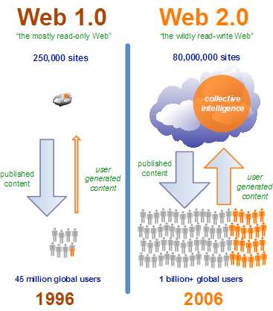
Web 1.0 to Web 2.0
Problems of Web 2.0:
80% of content comes from 20% of users
Data may not be high quality
Uncertainty of who to trust without knowing if the data is correct or not
Focus on the bi-directional sharing of content (increasing user-generated data)
Mainly expert-generated data
Notes:
Source: GP 187 Fall 2015 – L08 Web Mapping (by Prof. Peter Johnson)

Slide 5

Video – Two Minute Tutorials – What is OpenStreetMap? (1:48)
Notes:
Available buses changes throughout the day
The area reachable changes significantly

Slide 6
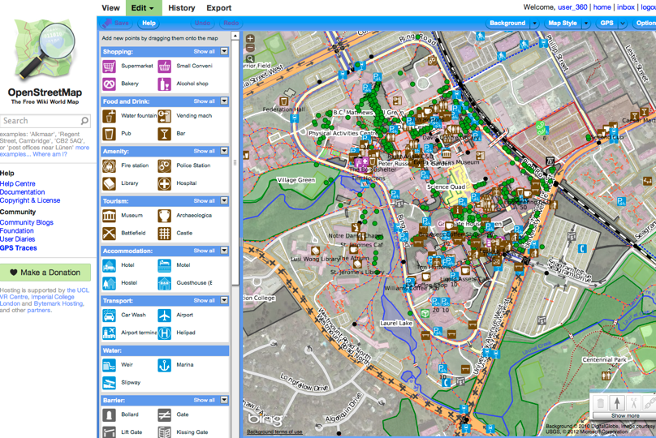
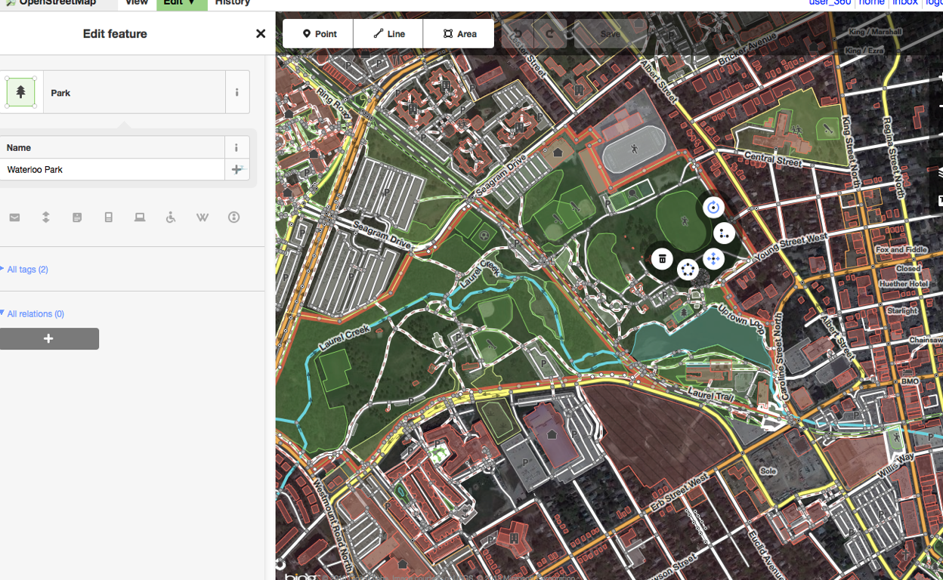
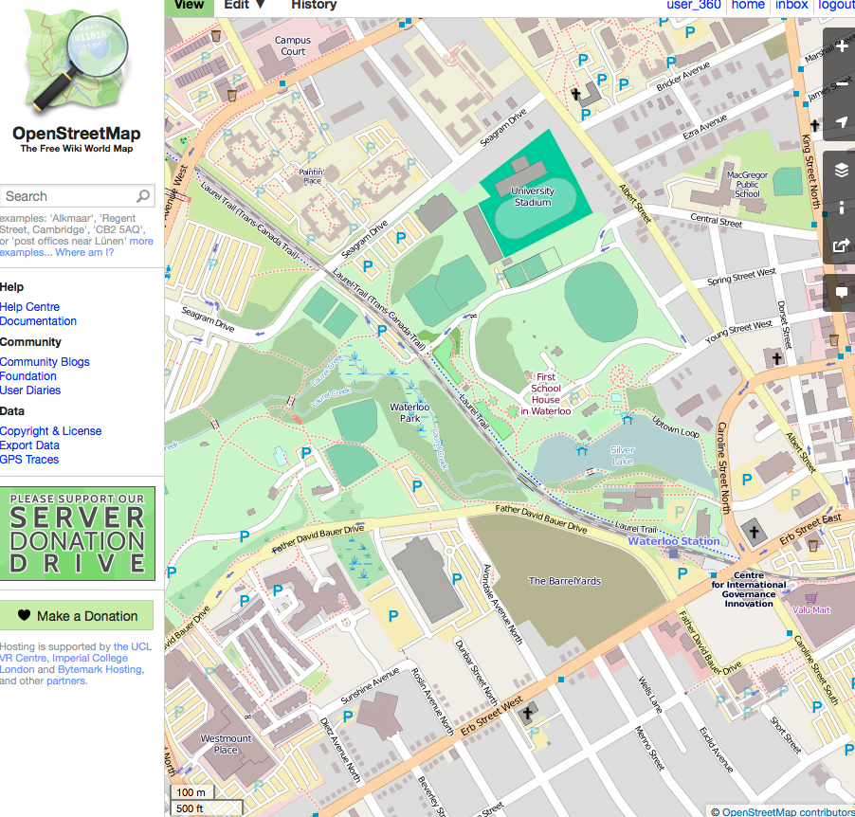
Introduction to OSM
Created by Steve Coast in the UK in 2004
Initially focused on mapping in the UK, then becoming more popular worldwide
More than 3 million registered users
Use of volunteered geographical data created by any users with a computer and a free account.
Notes:
Source: GEOG 483 Winter 2020 Week 1b – Slides 26 and 27

Slide 7
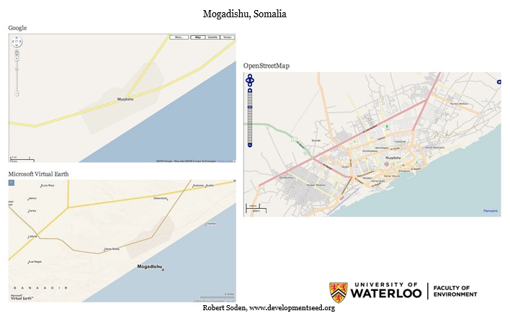
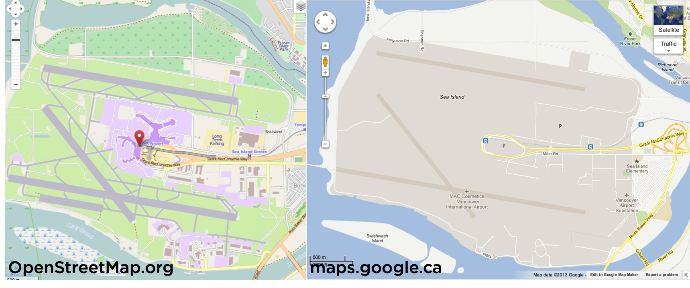
Comparison of OSM to other web maps
Notes:
Source: GEOG 483 Winter 2020 Week 1b – Slides 32 and 35

Slide 8
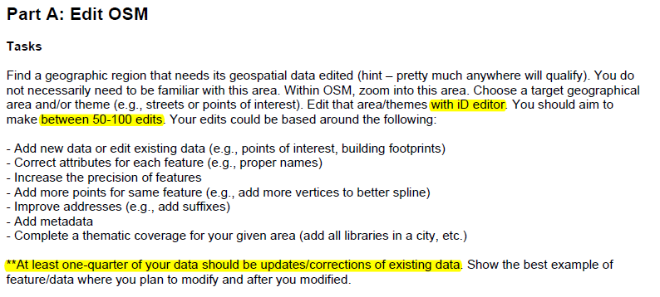
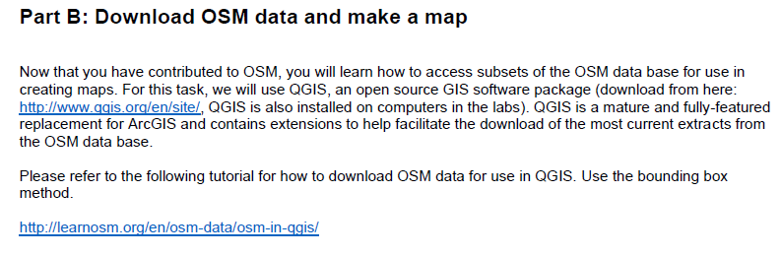
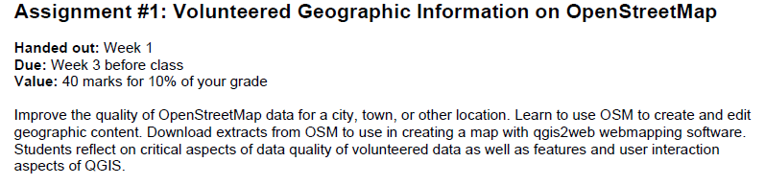
Example coursework (Geoweb and Location-Based Services- GEOG 483)

Slide 9
Demonstration in OSM
https://www.openstreetmap.org/

Slide 10
Questions?

Slide 11
2. Tutorial
Step 1: create an osm account and find an area to start editing (https://www.openstreetmap.org/)
Find some areas with missing buildings
Also update the attributes of some features
STEP 2: follow the tutorial here to download osm data for use in qgis: https://www.qgistutorials.com/en/docs/3/downloading_osm_data.html
STEP 3: create a web map in qgis using qgis2web plugin

